Slide 1
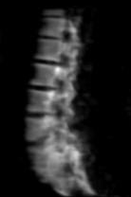
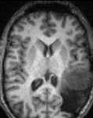
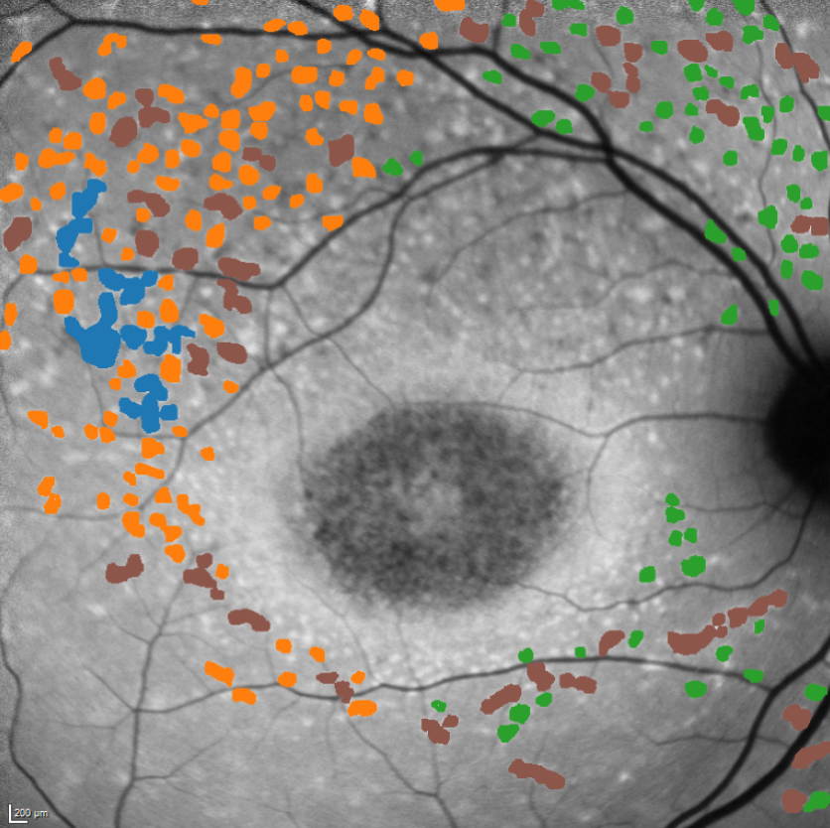
Segmentation (U-Net)
SPARK April 12, 2025
Craig Jones, PhD

Slide 2



Background
BSc (Hons) in Computing Science and Mathematics (Simon Fraser University)
MSc in Medical Biophysics (University of Western Ontario)
PhD in Physics (Medical Biophysics University of British Columbia)

Slide 3
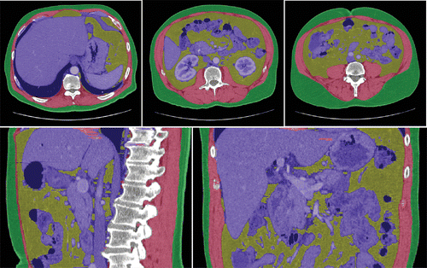
Overview for Segmentation
Images
Segmentation (Old School)
What is Ground Truth?
Augmentation
U-Net
U-Net Derivations and many many more
Segmentation Accuracy and Loss

Slide 4
Why segment?
Why do we want to segment images?

Slide 5
Why segment?
Why do we want to segment images?
Normal body region segmentation
Abnormal tissue segmentation
Changes over time
Changes with disease state

Slide 6
What regions of the body may be segmented?

Slide 7
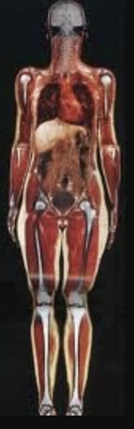
Body Regions
Brain / head
Neck
Shoulder
Heart
Abdomen
Pelvis
Extremities

Slide 8
Body Regions
Brain / head
Neck
Shoulder
Heart
Abdomen
Pelvis
Extremities
Anything!

Slide 9
Images

Slide 10
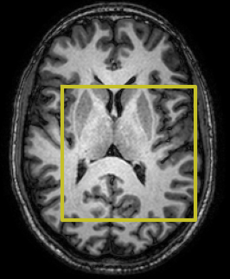
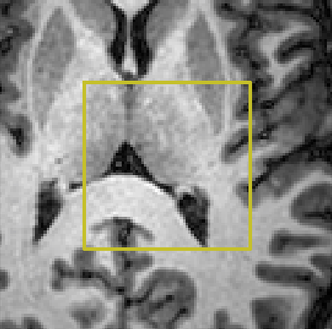
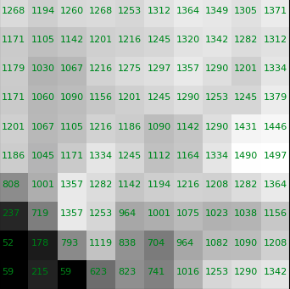
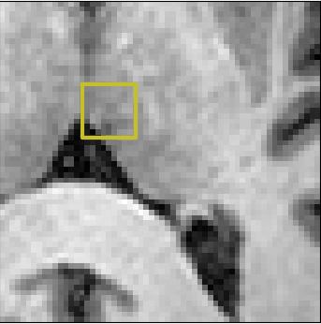
Interpretation of Numbers

Slide 11
What is an image?
Images are made up of pixels (picture element) or voxels (volume element)
Numbers in images may represent a physical unit or a relative value
CT images are in Hounsfield units (typically -500 – 3000)
MRI images are relative signal units (typically 0 – 2500)
absorption of high energy electromagnetic radiation from an x-ray tube in a patient
Human eye can distinguish approximately 100 shades of gray
Pixel

Slide 12
Segmentation

Slide 13
What is Segmentation?

Slide 14
How can we segment?
What are we looking for here?
Or… what is the computer algorithm looking for?
Pixel

Slide 15
How can we segment?
Changes in voxel signal across a consistent space
Contrast (difference in signal in a close proximity)
Pixel

Slide 16
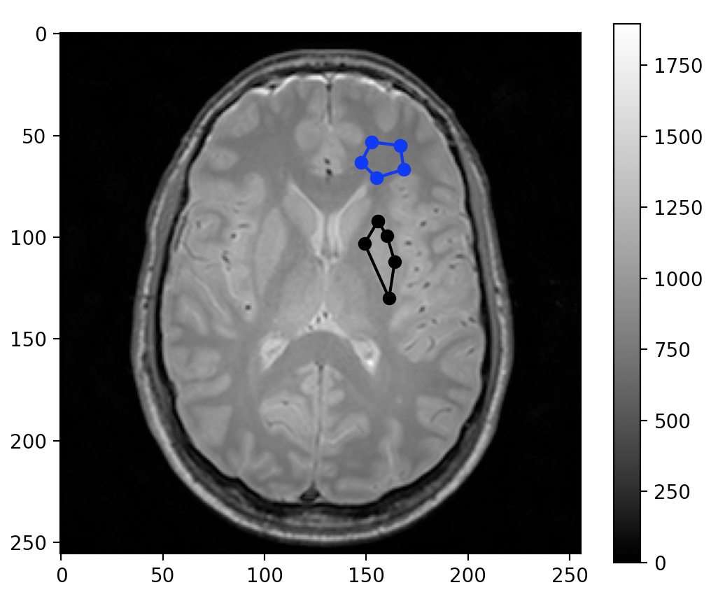
What is Contrast?

Slide 17
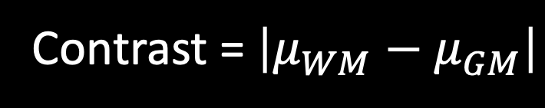
Contrast
Contrast is the difference in signal between two regions
Contrast can be signal difference between tissue and background
Contrast = $\left|μ_{WM}−μ_{GM}\right|$

Slide 18
What is the contrast to noise ratio?

Slide 19
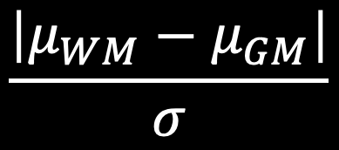
Contrast to Noise Ratio
Difference in signal divided by a measure of noise.
$$\frac{\left|μ_{WM}−μ_{GM}\right|}{σ}$$
CNR =

Slide 20
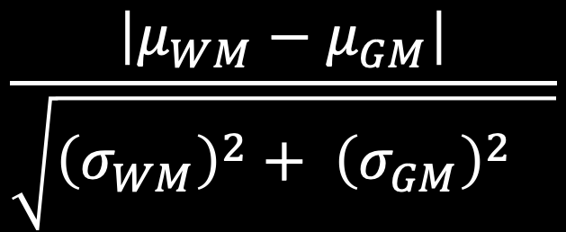
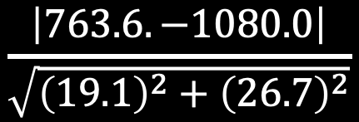
Contrast to Noise Ratio
$$\frac{\left|μ_{WM}−μ_{GM}\right|}{\sqrt{{\left(σ_{WM}\right)}^{2}+ {{\left(σ_{GM}\right)}^{2}}_{}}}$$
CNR =
$$\frac{\left|763.6. −1080.0\right|}{\sqrt{{\left(19.1\right)}^{2}+{\left(26.7\right)}^{2}}}$$
CNR =
= 9.6

Slide 21
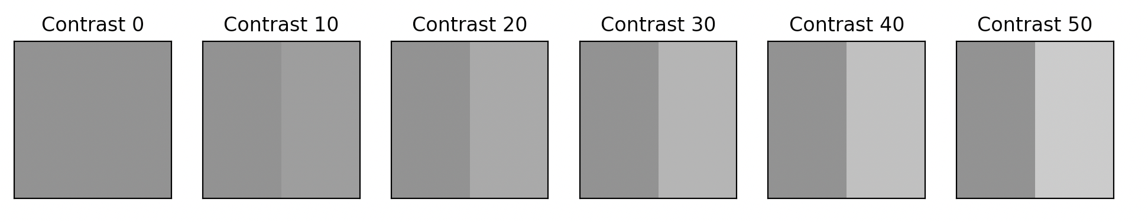
Contrast
plt.figure(2, figsize=[12, 5])
plt.clf()
for ii, sig in enumerate([100, 110, 120, 130, 140, 150]):
A = np.zeros((256,256))
A[:,:128] = 100
A[:,128:] = sig
plt.subplot(1,6,ii+1)
plt.imshow(A)
plt.xticks([])
plt.yticks([])
plt.clim((0, 200))
plt.title(f'Contrast {sig-100}')
plt.show()

Slide 22
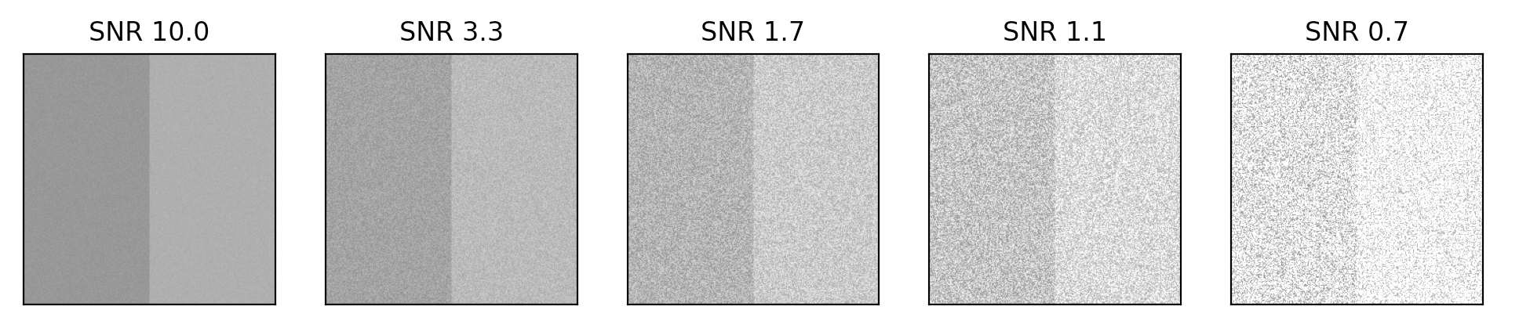
Contrast to Noise
plt.figure(3, figsize=[12, 5])
plt.clf()
for ii, sig in enumerate([10, 30, 60, 90, 150]):
A = np.zeros((256,256))
A[:,:128] = 100
A[:,128:] = 120
noise = sig*np.random.rand(256,256)
plt.subplot(1,5,ii+1)
plt.imshow(A + noise)
plt.xticks([])
plt.yticks([])
plt.clim((0, 200))
plt.title(f'SNR {100/sig:3.1f}')
plt.show()

Slide 23
What is Segmentation?
the process of partitioning a digital image into multiple image segments, also known as image regions or image objects (sets of pixels)
https://en.wikipedia.org/wiki/Image_segmentation

Slide 24
Segmentation Categories

Slide 25
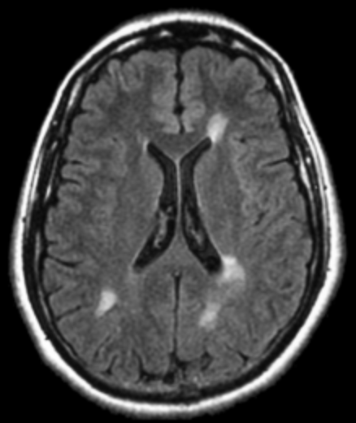
Segmentation Categories
Hard Segmentation
Mask is binary (assuming two classes, background and lesion)
Fuzzy Segmentation
Mask is floating point (typically range from 0 and 1)
Each pixel is weighted by inclusion

Slide 26
Segmentation Categories
What are the two broad segmentation categories?

Slide 27
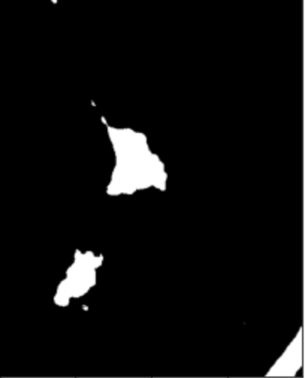
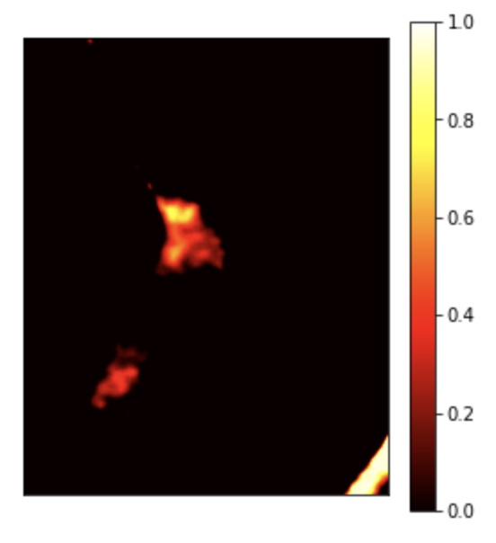
Segmentation Categories
Hard Segmentation
Mask is binary (assuming two classes, background and lesion)
Fuzzy Segmentation
Mask is floating point (typically range from 0 and 1)
Each pixel is weighted by inclusion

Slide 28
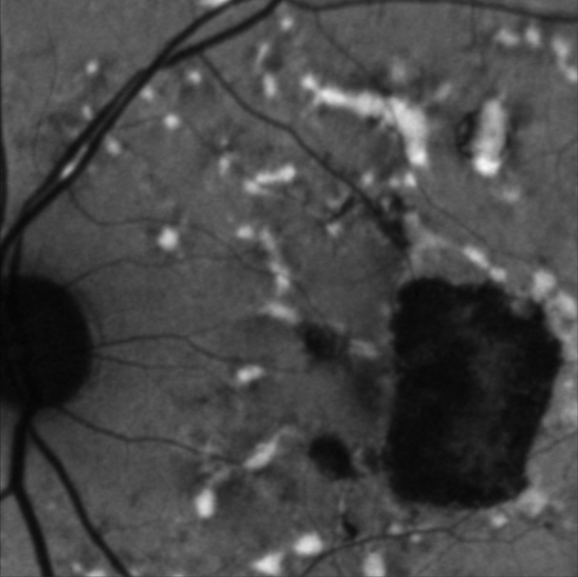
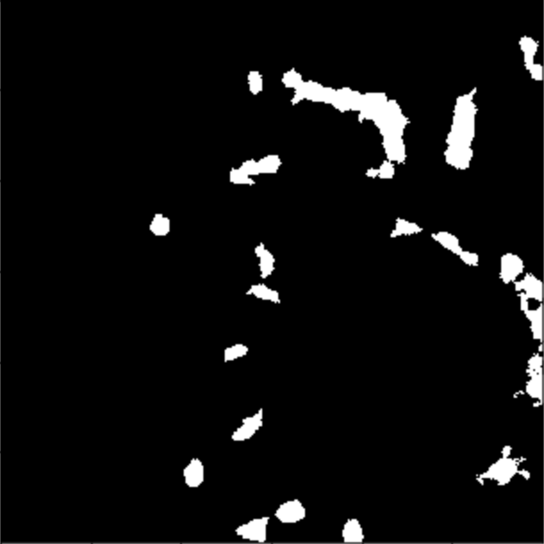
Hard Segmentation
Semantic segmentation: for every pixel, belonging class of the object

Slide 29
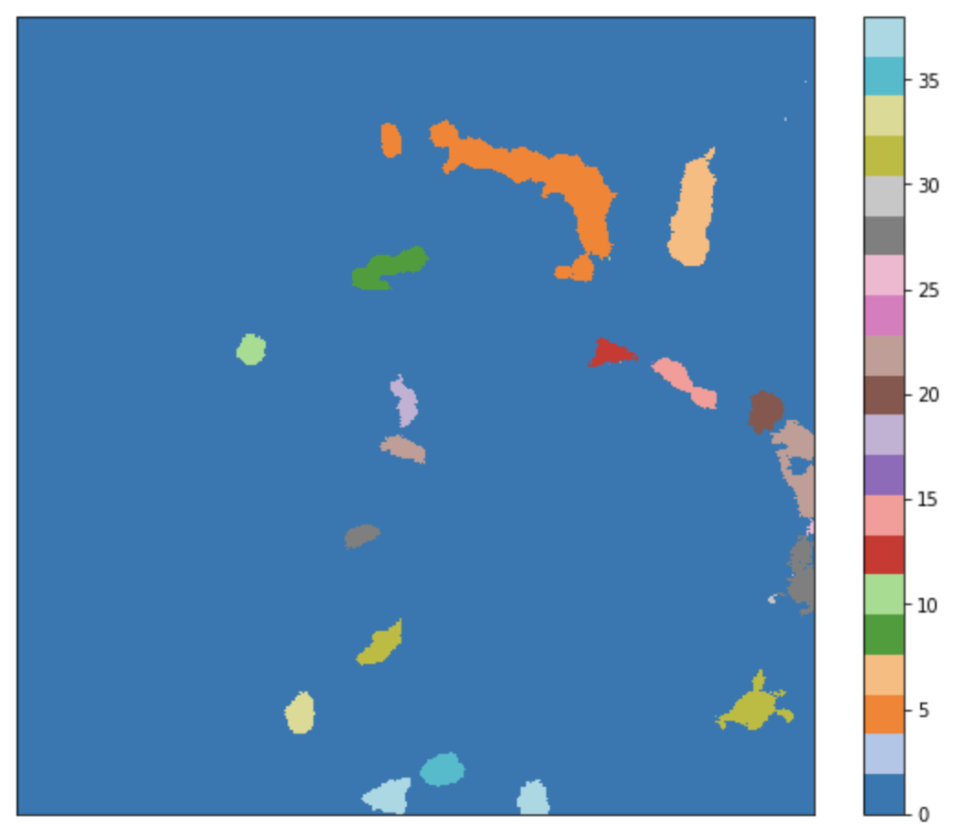
Hard Segmentation
Instance segmentation: for every pixel, belonging class of the object
scipy.ndimage.label()

Slide 30
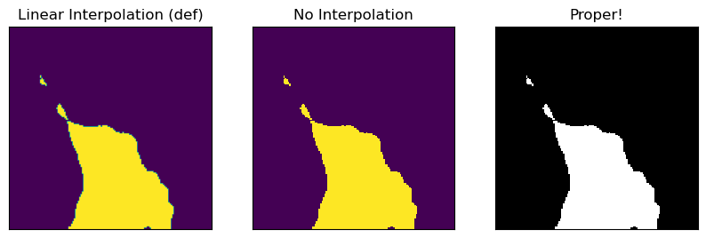
Proper MatplotLib for Masks

Slide 31
Proper MatplotLib for Masks
plt.figure(figsize=[10,5])
mask_hard = image_lesion[mask_lesion] > 150
plt.subplot(1,3,1)
plt.imshow(mask_hard[100:250,100:250])
plt.xticks([])
plt.yticks([])
plt.title('Linear Interpolation (def)')
plt.subplot(1,3,2)
plt.imshow(mask_hard[100:250,100:250], interpolation='none')
plt.xticks([])
plt.yticks([])
plt.title('No Interpolation')
plt.subplot(1,3,3)
plt.imshow(mask_hard[100:250,100:250], 'gray', interpolation='none')
plt.xticks([])
plt.yticks([])
plt.title('Proper!')

Slide 32
Threshold Based Segmentation

Slide 33
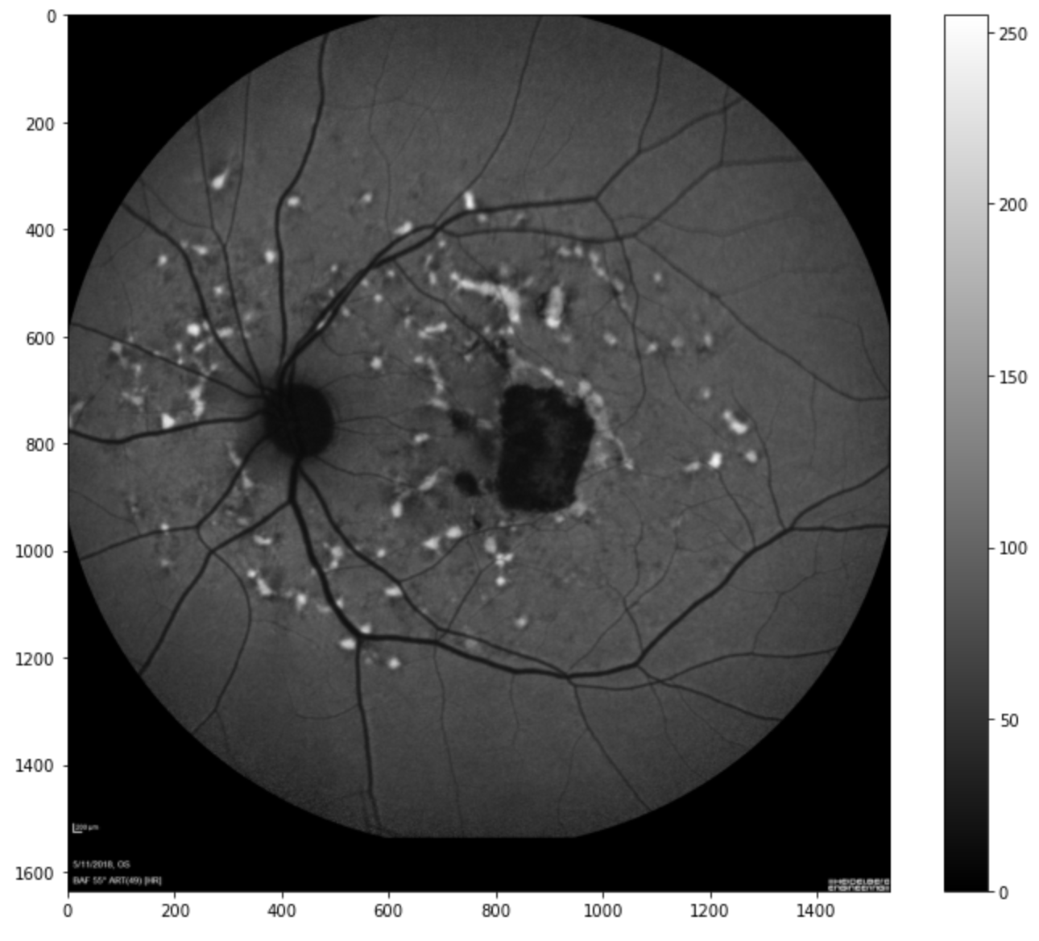
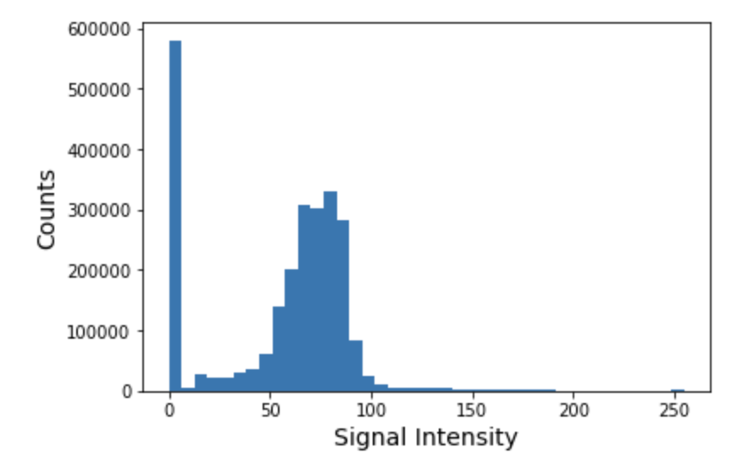
Threshold Based Segmentation
Histogram of the Image

Slide 34
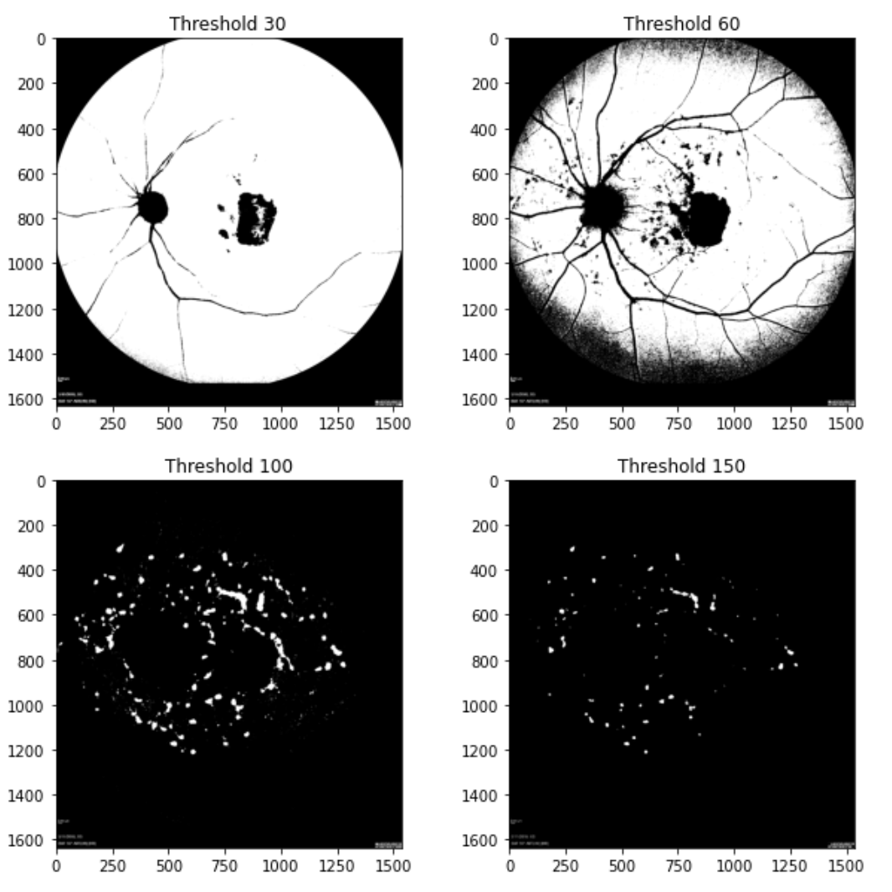
Histogram Threshold Values

Slide 35
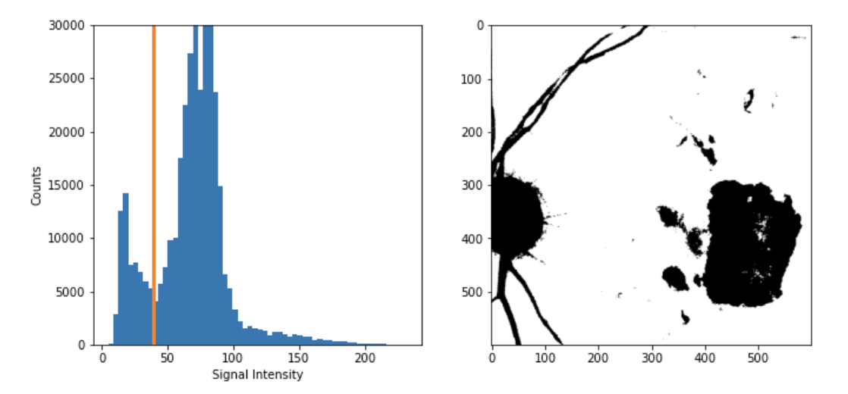
Threshold Segmentation Summary
Pros
One of the simplest methods to segment an image
Easy to choose a threshold value
Segment into numerous regions
Cons
Difficult to adapt to artifacts in the image
All spatial information is lost
For most segmentation, neural networks and deep learning are likely going to be the direction to follow.

Slide 36
Ground Truth Masks

Slide 37
Ground Truth Masks
How do we create a Ground Truth?
What is Ground Truth?

Slide 38
Importance of Ground Truth Masks
Foundation for Training: Ground truth masks are the basis for training deep learning models in medical image segmentation.
Evaluation Metric: They are used to evaluate the performance of segmentation models.
Data Augmentation: They can be used to generate synthetic data for training.
Quality Control: They can be used to identify errors in the segmentation process.

Slide 39
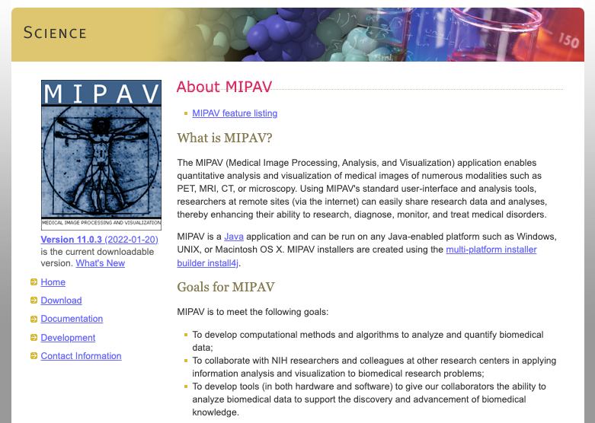
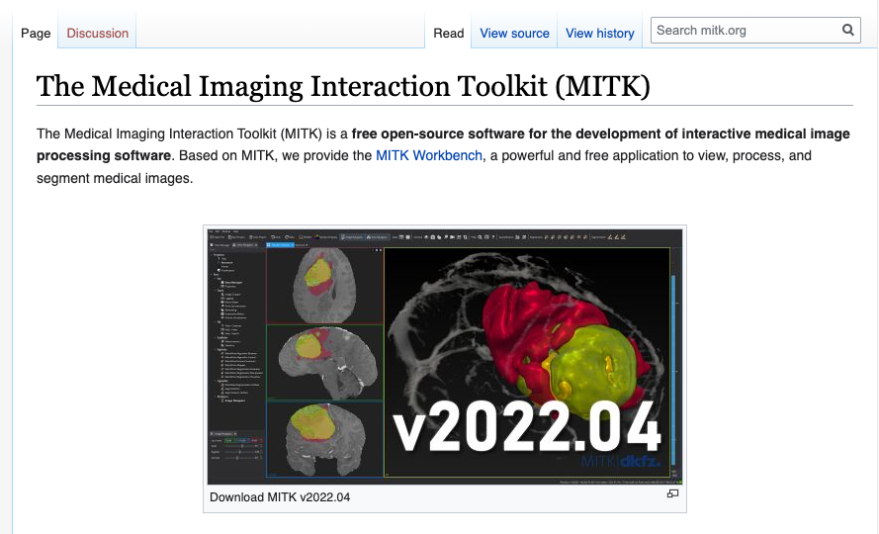
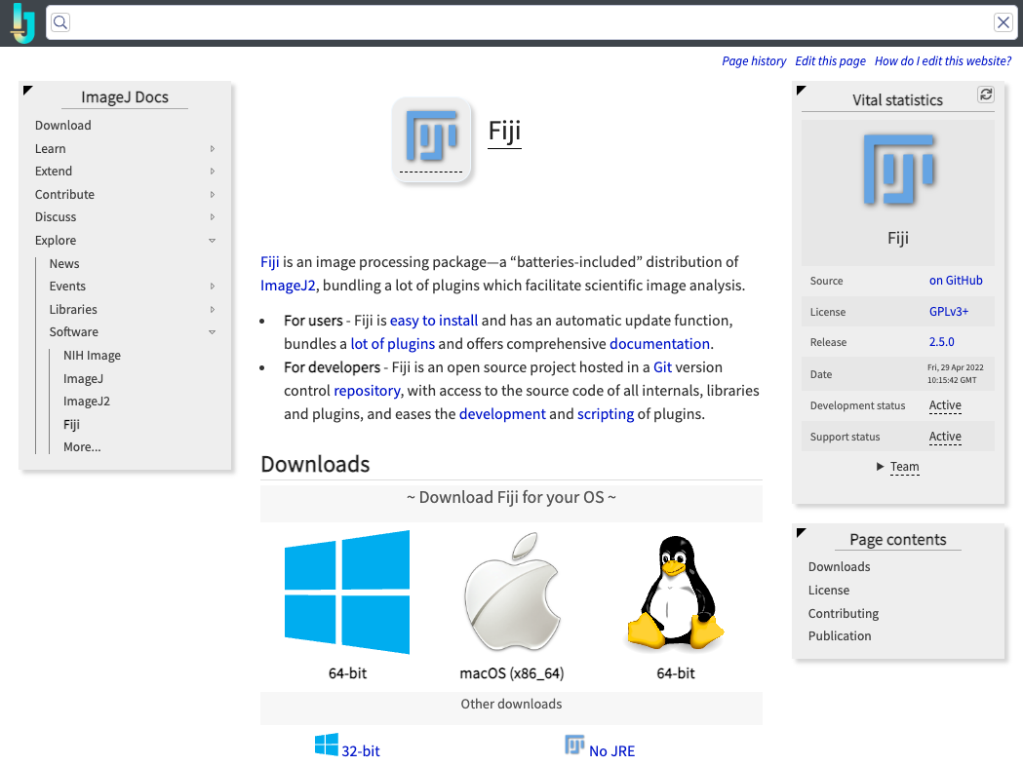
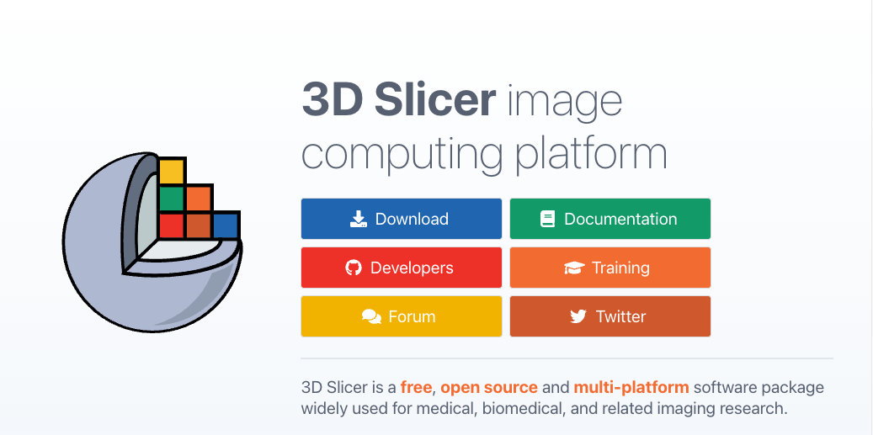
Software to Create Ground Truth Masks

Slide 40
Ground Truth Masks
Who is going to create the masks?

Slide 41
Ground Truth Masks
Who is going to create the masks?
Radiologist or other medical doctor
Medical Fellow
Graduate Student
What do we need to consider for each?

Slide 42
Ground Truth Masks
ALWAYS Check them!!
Don’t assume the masks are correct.
Read them in using your software of choice (e.g., Python)
Create slides with examples to make sure the segmentations are good.
For example, to make sure they are not flipped left/right
Could be saved as floating point number

Slide 43
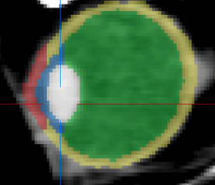
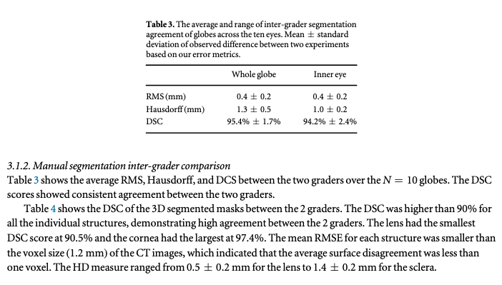
Ground Truth Masks
Inter-rater Reliability: Assessing the agreement between multiple annotators.
Visual Inspection: Manually checking the quality of the annotations.
Quantitative Metrics: Evaluating the performance of the segmentation model on a held-out test set.
https://doi.org/10.1088/1361-6560/ac9a98

Slide 44
U-Net

Slide 45
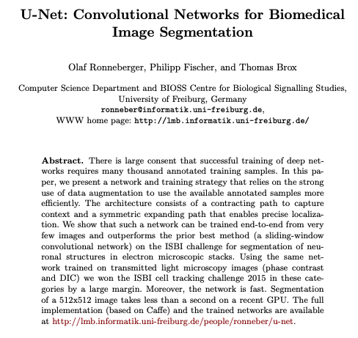
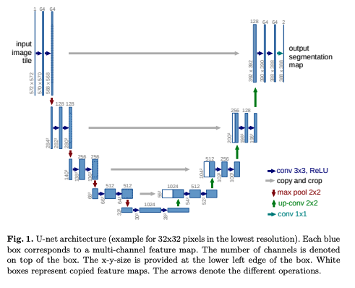
U-Net!
https://arxiv.org/pdf/1505.04597
DOI: 10.1007/978-3-319-24574-4_28

Slide 46
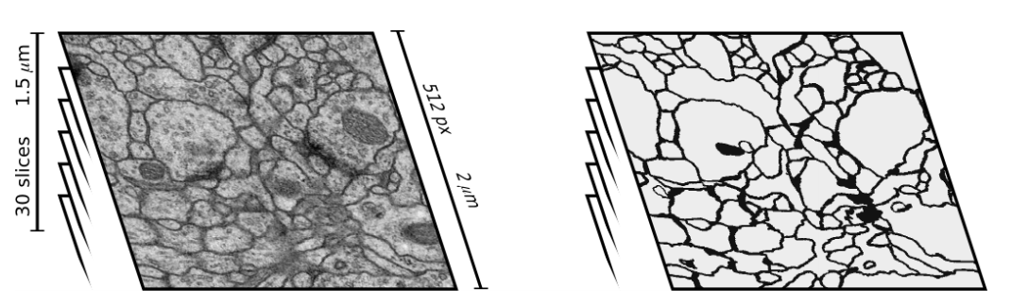
U-Net
Stacks of Electron microscopy (EM) images
EM segmentation challenge at ISBI 2012
30 training images
Black - neuron membranes
White - cells
Training stack
Ground truth

Slide 47
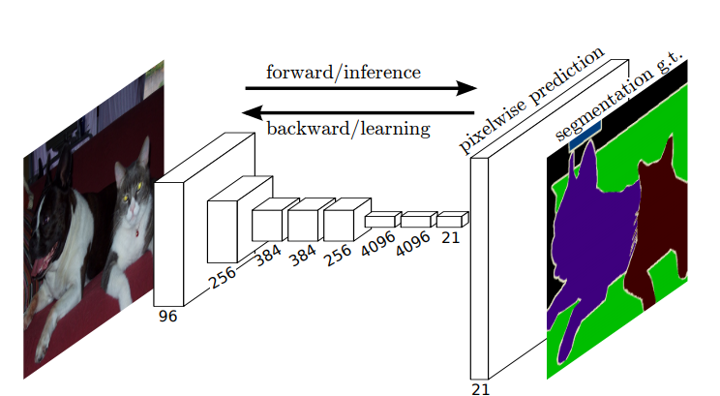
Prior to U-Net
Fully convolutional neural network (FCN) architecture for semantic segmentation
Localization and the use of context at the same time
Input image with any size

Slide 48

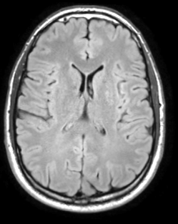
Encoding / Embedding
What is an embedding (or encoding)?

Slide 49
Encoding / Embedding
The image passes through convolutions
The final layer before the output is typically a fully connected layer
This can be considered the embedding

Slide 50
U-Net – The Basics
Contracting Path (Encoder):
Extracts features using repeated convolutional layers with ReLU activation and max pooling.
Reduces spatial dimensions while increasing feature channels.
Encoder
Decoder
Adapted from: Olaf Ronneberger, Philipp Fischer, and Thomas Brox

Slide 51
U-Net – The Basics
Expanding Path (Decoder):
Upsamples feature maps using "up-convolutions."
Combines low-level features from the encoder via skip connections for precise localization.
Symmetry: The U-shaped design ensures balance between feature extraction and spatial resolution.
Encoder
Decoder
Adapted from: Olaf Ronneberger, Philipp Fischer, and Thomas Brox

Slide 52
U-Net – Key Innovations
Resolution:
The encoder path of the UNet progressively downsamples the input image, capturing crucial contextual information and hierarchical features at lower resolutions (what is where).
The decoder path upsamples these lower-resolution feature maps to generate the final segmentation map
Upsampling process alone can lead to a loss of fine-grained spatial details present in the original high-resolution input.
Preserving Fine-Grained Details with Skip Connections:
Skip connections are direct pathways that copy feature maps from corresponding layers in the encoder to the decoder.
These high-resolution feature maps from the encoder contain rich spatial information (e.g., edges, textures, boundaries) that is crucial for accurate segmentation, especially of intricate anatomical structures.
Encoder
Decoder

Slide 53
U-Net – Key Innovations
Skip Connections:
Reintroduce spatial details lost during down sampling, enhancing segmentation accuracy.
Advantages:
High accuracy with small datasets.
Efficient processing of large images
Encoder
Decoder

Slide 54
U-Net – Key Innovations
At each level of the decoder, the upsampled feature maps (carrying contextual information) are concatenated with the corresponding high-resolution feature maps from the encoder (carrying spatial details).
Concatenation is a crucial operation that combines these two complementary streams of information without losing either. It essentially stacks the feature channels together.
Encoder
Decoder

Slide 55
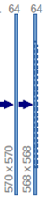
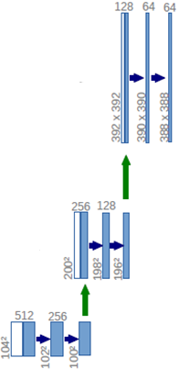
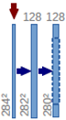
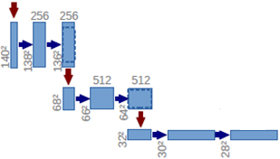
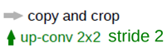
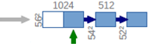
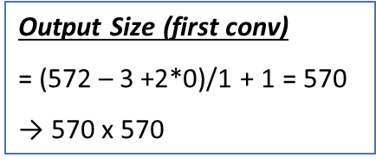
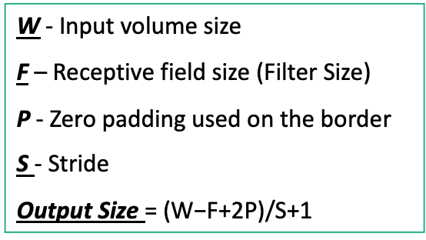
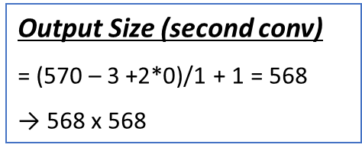
U-Net
Output
segmentation map
(here 2 classes)
background and
foreground
Input
image
tile
Concatenation with
high-resolution features
from contracting path
Output Size (second conv)
= (570 – 3 +2*0)/1 + 1 = 568
→ 568 x 568
Create high-resolution
segmentation map
Contraction
Expansion
Increase the “What”
Reduce the “Where”
W - Input volume size
F – Receptive field size (Filter Size)
P - Zero padding used on the border
S - Stride
Output Size $\text{=} \text{(}\text{W}\text{−}\text{F}\text{+2}\text{P}\text{)/}\text{S}\text{+1}$
Output Size (first conv)
= (572 – 3 +2*0)/1 + 1 = 570
→ 570 x 570
Adapted from: Olaf Ronneberger, Philipp Fischer, and Thomas Brox

Slide 56
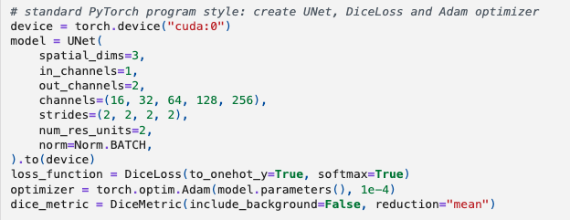
U-Net Monai
Encoder
Decoder

Slide 57
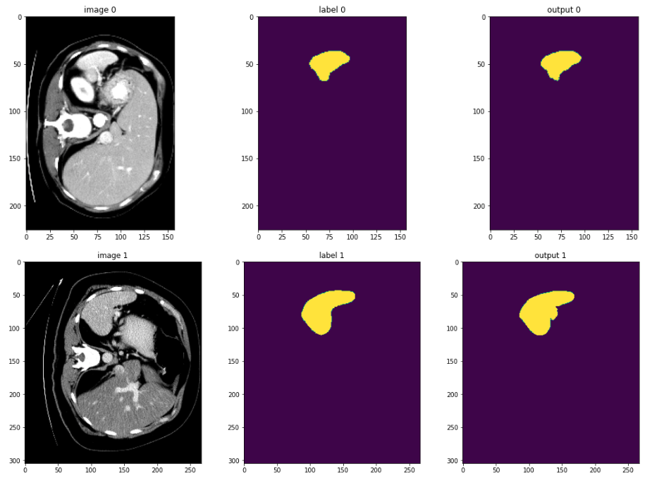
U-Net Monai
https://github.com/Project-MONAI/tutorials/blob/main/3d_segmentation/spleen_segmentation_3d.ipynb
https://docs.monai.io/en/stable/networks.html#nets

Slide 58
U-Net Variations

Slide 59
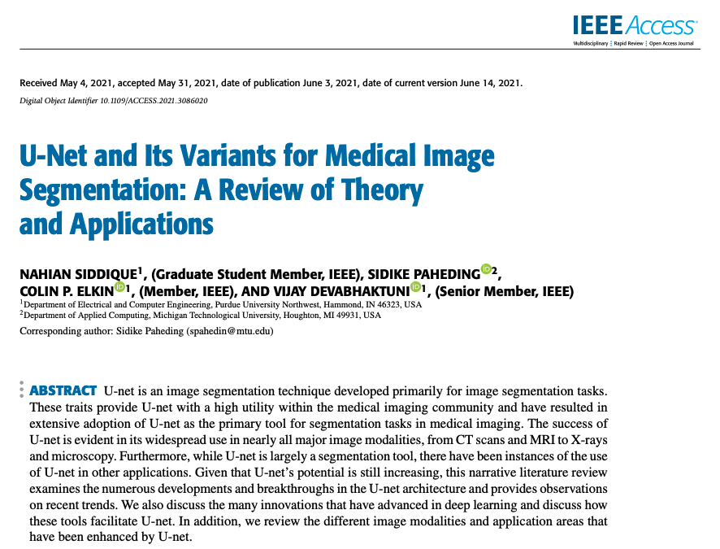

Many Papers on Variations
DOI: 10.1109/ACCESS.2021.3086020
DOI: 10.53941/ijndi.2024.100009

Slide 60


UNet++: A Nested and Densely Connected UNet
Key Architectural Modifications:
Nested UNet Architectures: Introduces a series of nested U-Nets with varying depths.
Dense Skip Connections: Connects encoder layers to multiple decoder layers at the same and higher levels, facilitating richer feature aggregation.
Advantages for MRI Segmentation:
Improved Feature Aggregation: Dense skip connections allow the decoder to access multi-scale features more effectively, capturing both local and global context.
Enhanced Detail Preservation: The nested structure and dense connections can better preserve fine-grained details crucial for accurate segmentation of complex anatomical structures.
Potentially More Robust to Noise: The aggregation of features from different depths might lead to increased robustness.
Potential Drawbacks:
Increased model complexity and number of parameters compared to the original UNet.
Longer training times due to the deeper and more interconnected architecture.
The optimal depth and number of nested UNets might require careful tuning.
arXiv:1807.10165v1

Slide 61


VNet: Focusing on Relevant Features
Advantages of VNet
Direct 3D Processing: This allows the network to learn spatial relationships across all three
Preservation of Volumetric Information: Avoiding aggressive downsampling like max-pooling (V-Net uses strided convolutions for downsampling), V-Net aims to preserve more volumetric information throughout the network.
Improved Gradient Flow: The inclusion of short residual connections helps to mitigate the vanishing gradient problem, allowing for the training of deeper and potentially more powerful networks.
Potential Drawbacks of V-Net for MRI Segmentation:
Higher Computational Cost and Memory Requirements
Increased Data Requirements: Training deep 3D networks effectively often requires larger and more diverse datasets to avoid overfitting, which can be a challenge in medical imaging where labeled 3D data can be scarce.
Potential for Overfitting on Small 3D Datasets: V-Net's increased capacity might lead to overfitting if not carefully regularized.
Sensitivity to Anisotropic Voxel Spacing: Might be more sensitive to highly anisotropic voxel spacing (different resolutions along x, y, and z axes) if not handled appropriately during preprocessing.
arXiv:1606.04797v1

Slide 62


Attention UNet: Focusing on Relevant Features
Key Architectural Modifications:
Attention Gates (AGs): Introduced in the skip connections to suppress irrelevant feature activations from the encoder while highlighting salient features for the decoder.
AGs learn to weight the encoder features based on the corresponding decoder features, allowing the model to focus on task-relevant regions.
Advantages for MRI Segmentation:
Improved Segmentation Accuracy: By focusing on relevant features, Attention UNets can achieve more accurate segmentation, especially in challenging regions.
Enhanced Handling of Background Noise and Irrelevant Structures: The attention mechanism helps the model to ignore noise and focus on the target anatomical structures.
Better Localization: By highlighting important features, the model can improve the localization of the segmented regions.
Potential Drawbacks:
Increased computational cost due to the added attention gate modules.
The effectiveness of attention mechanisms can depend on the specific characteristics of the MRI data and the segmentation task.
arXiv:1804.03999v3

Slide 63
U-Net….
Core UNet Variations (Addressing Fundamental Limitations):
UNet++: Introduces nested and dense skip connections, along with deep supervision
Attention UNet: Integrates attention gates into the skip connections
ResUNet: Incorporates residual connections within the convolutional
DenseUNet: Employs dense blocks (as in DenseNet) within the UNet architecture
V-Net: Specifically designed for volumetric (3D) medical image segmentation
3D UNet: A direct extension of the original UNet to process 3D volumetric data using 3D convolutional layers.
Variations Incorporating Specific Modules/Techniques:
TransUNet: Combines the U-Net architecture with Transformer networks to capture long-range dependencies
Swin-UNet: Integrates the Swin Transformer architecture (based on shifted windows) as the encoder
UNet with Squeeze-and-Excitation (SE) Blocks: Adds SE blocks to the convolutional layers
UNet with Convolutional Block Attention Module (CBAM): Integrates CBAM
UNet with Deformable Convolutions: Uses deformable convolutional layers
MultiResUNet: Replaces standard convolutional blocks with MultiRes blocksDoubleUNet: Cascades two UNet-like architectures, where the output of the first UNet serves as an additional input to the second, aiming for refinement and improved segmentation.
UNet with Atrous/Dilated Convolutions: Incorporates atrous convolutions to increase the receptive field
nnUNet (no-new-Net): While it primarily uses a standard UNet or a 3D
So many!!!

Slide 64
U-Net….
Core UNet Variations (Addressing Fundamental Limitations):
UNet++: Introduces nested and dense skip connections, along with deep supervision
Attention UNet: Integrates attention gates into the skip connections
ResUNet: Incorporates residual connections within the convolutional
DenseUNet: Employs dense blocks (as in DenseNet) within the UNet architecture
V-Net: Specifically designed for volumetric (3D) medical image segmentation
3D UNet: A direct extension of the original UNet to process 3D volumetric data using 3D convolutional layers.
Variations Incorporating Specific Modules/Techniques:
TransUNet: Combines the U-Net architecture with Transformer networks to capture long-range dependencies
Swin-UNet: Integrates the Swin Transformer architecture (based on shifted windows) as the encoder
UNet with Squeeze-and-Excitation (SE) Blocks: Adds SE blocks to the convolutional layers
UNet with Convolutional Block Attention Module (CBAM): Integrates CBAM
UNet with Deformable Convolutions: Uses deformable convolutional layers
MultiResUNet: Replaces standard convolutional blocks with MultiRes blocksDoubleUNet: Cascades two UNet-like architectures, where the output of the first UNet serves as an additional input to the second, aiming for refinement and improved segmentation.
UNet with Atrous/Dilated Convolutions: Incorporates atrous convolutions to increase the receptive field
nnUNet (no-new-Net): While it primarily uses a standard UNet or a 3D
So many!!!
How do I choose??

Slide 65
nnU-Net
Self-Configuring Deep Learning for Robust Performance

Slide 66

"No New Net": Embracing Existing Architectures with Adaptive Configuration
nnU-Net utilizes a standard UNet (or slight variations) but focuses on automatically adapting its configuration to the specific dataset.
Sophisticated pre-processing, network architecture selection (within a defined space), training scheme, and post-processing, all determined adaptively.
Tuning network architectures for each new MRI segmentation task.
Goal of achieving state-of-the-art performance with minimal user intervention.
https://doi.org/10.1038/s41592-020-01008-z

Slide 67

nnU-Net
https://github.com/MIC-DKFZ/nnUNet

Slide 68
Intelligent Dataset Analysis and Preprocessing
Dataset Fingerprinting: nnUNet analyzes the input MRI dataset to extract crucial statistical information (e.g., image sizes, voxel spacing, intensity ranges, number of modalities, class distributions).
Automatically configured based on the dataset fingerprint:
Adapting normalization strategies (e.g., z-score, clipping) based on intensity distributions.
Intelligent resampling to a common isotropic or anisotropic target spacing based on the original data characteristics to ensure consistent input sizes for the network.
Automatic cropping to the region of interest to reduce computational load and focus on relevant areas.
Addressing varying voxel spacing in different dimensions.
Crucial for standardizing the input data and improving the robustness and performance of the subsequent network training.

Slide 69

nnU-Net: Strengths, Considerations, and Future Directions
Advantages of nnUNet for MRI Segmentation:
High Performance: Achieves state-of-the-art results across a wide range of MRI segmentation tasks.
Reduced User Effort: Minimizes the need for manual hyperparameter tuning and architecture design.
Robustness and Generalization: Adaptive configuration and strong augmentation lead to better generalization across diverse datasets.
Reproducibility: Provides a standardized and well-documented framework.
Scalability: Can handle large and complex MRI datasets.
Potential Limitations:
Black Box Nature: The automated configuration can make it harder to understand the specific design choices for a given task.
Computational Resources: Training can still be computationally intensive, although optimized.
Adaptability to Novel Architectures: Primarily relies on UNet-like architectures.
Conclusion:
Significant contribution to the field of medical image segmentation, particularly for MRI.

Slide 70
U-Net….
Core UNet Variations (Addressing Fundamental Limitations):
UNet++: Introduces nested and dense skip connections, along with deep supervision
Attention UNet: Integrates attention gates into the skip connections
ResUNet: Incorporates residual connections within the convolutional
DenseUNet: Employs dense blocks (as in DenseNet) within the UNet architecture
V-Net: Specifically designed for volumetric (3D) medical image segmentation
3D UNet: A direct extension of the original UNet to process 3D volumetric data using 3D convolutional layers.
Variations Incorporating Specific Modules/Techniques:
TransUNet: Combines the U-Net architecture with Transformer networks to capture long-range dependencies
Swin-UNet: Integrates the Swin Transformer architecture (based on shifted windows) as the encoder
UNet with Squeeze-and-Excitation (SE) Blocks: Adds SE blocks to the convolutional layers
UNet with Convolutional Block Attention Module (CBAM): Integrates CBAM
UNet with Deformable Convolutions: Uses deformable convolutional layers
MultiResUNet: Replaces standard convolutional blocks with MultiRes blocksDoubleUNet: Cascades two UNet-like architectures, where the output of the first UNet serves as an additional input to the second, aiming for refinement and improved segmentation.
UNet with Atrous/Dilated Convolutions: Incorporates atrous convolutions to increase the receptive field
nnUNet (no-new-Net): While it primarily uses a standard UNet or a 3D
So many!!!
How do I choose??

Slide 71
U-Net….
Core UNet Variations (Addressing Fundamental Limitations):
UNet++: Introduces nested and dense skip connections, along with deep supervision
Attention UNet: Integrates attention gates into the skip connections
ResUNet: Incorporates residual connections within the convolutional
DenseUNet: Employs dense blocks (as in DenseNet) within the UNet architecture
V-Net: Specifically designed for volumetric (3D) medical image segmentation
3D UNet: A direct extension of the original UNet to process 3D volumetric data using 3D convolutional layers.
Variations Incorporating Specific Modules/Techniques:
TransUNet: Combines the U-Net architecture with Transformer networks to capture long-range dependencies
Swin-UNet: Integrates the Swin Transformer architecture (based on shifted windows) as the encoder
UNet with Squeeze-and-Excitation (SE) Blocks: Adds SE blocks to the convolutional layers
UNet with Convolutional Block Attention Module (CBAM): Integrates CBAM
UNet with Deformable Convolutions: Uses deformable convolutional layers
MultiResUNet: Replaces standard convolutional blocks with MultiRes blocksDoubleUNet: Cascades two UNet-like architectures, where the output of the first UNet serves as an additional input to the second, aiming for refinement and improved segmentation.
UNet with Atrous/Dilated Convolutions: Incorporates atrous convolutions to increase the receptive field
nnUNet (no-new-Net): While it primarily uses a standard UNet or a 3D
Ask the question about what why you are doing the work?
Is this for “simply” application of a medical question?
Or are you interested in developing the theory of neural networks?

Slide 72
U-Net….
Core UNet Variations (Addressing Fundamental Limitations):
UNet++: Introduces nested and dense skip connections, along with deep supervision
Attention UNet: Integrates attention gates into the skip connections
ResUNet: Incorporates residual connections within the convolutional
DenseUNet: Employs dense blocks (as in DenseNet) within the UNet architecture
V-Net: Specifically designed for volumetric (3D) medical image segmentation
3D UNet: A direct extension of the original UNet to process 3D volumetric data using 3D convolutional layers.
Variations Incorporating Specific Modules/Techniques:
TransUNet: Combines the U-Net architecture with Transformer networks to capture long-range dependencies
Swin-UNet: Integrates the Swin Transformer architecture (based on shifted windows) as the encoder
UNet with Squeeze-and-Excitation (SE) Blocks: Adds SE blocks to the convolutional layers
UNet with Convolutional Block Attention Module (CBAM): Integrates CBAM
UNet with Deformable Convolutions: Uses deformable convolutional layers
MultiResUNet: Replaces standard convolutional blocks with MultiRes blocksDoubleUNet: Cascades two UNet-like architectures, where the output of the first UNet serves as an additional input to the second, aiming for refinement and improved segmentation.
UNet with Atrous/Dilated Convolutions: Incorporates atrous convolutions to increase the receptive field
nnUNet (no-new-Net): While it primarily uses a standard UNet or a 3D
Start with the nn-UNet
So many!!!
How do I choose??

Slide 73


Data and Neural Networks
What is Data Augmentation?

Slide 74
Data and Neural Networks
Load the Training and Validation Data
Setup Data Augmentation
Setup model, loss function and optimizer
Load Batch of Training Data
Evaluate the Model
Training
Compute Training Loss
Data
Augmentation
Run Back Propagation
Epoch Loop
Compute Training Metrics
Load Batch of Validation Data
Validation
Evaluate the Model
Compute the Validation Loss
Compute Validation Metrics

Slide 75


Data and Neural Networks – Pre-Processing

Slide 76


Data and Neural Networks - Augmentation

Slide 77
Segmentation Loss Functions

Slide 78

Understanding Loss Functions for Neural Network Segmentation
Segmentation: The task of assigning a class label to each pixel (semantic) or identifying and delineating individual objects (instance).
Loss Functions: Crucial components that quantify the difference between the network's predictions and the ground truth.
Objective: To provide a comprehensive overview of common and advanced loss functions used in neural network segmentation.
Importance: Choosing the right loss function significantly impacts the performance and quality of segmentation results.
https://www.v7labs.com/blog/cross-entropy-loss-guide

Slide 79
How Loss Functions Drive Learning
Quantifying Error: Loss functions measure the discrepancy between the predicted segmentation map and the true segmentation mask.
Gradient Descent: The loss value is used to calculate gradients, which guide the network's weight updates during training.
Optimization Objective: The goal of training is to minimize the chosen loss function, leading to improved segmentation accuracy.
Task-Specific Design: Different segmentation tasks (semantic vs. instance) and data characteristics often necessitate different loss function choices.
Impact on Output: The loss function influences the characteristics of the learned segmentation maps (e.g., boundary sharpness, class balance).
Load the Training and Validation Data
Setup Data Augmentation
Setup model, loss function and optimizer
Load Batch of Training Data
Evaluate the Model
Training
Compute Training Loss
Run Back Propagation
Epoch Loop
Compute Training Metrics
Load Batch of Validation Data
Validation
Evaluate the Model
Compute the Validation Loss
Compute Validation Metrics

Slide 80

The Foundation: Pixel-Wise Cross-Entropy
Applies the standard cross-entropy loss independently to each pixel.
Treats each pixel classification as a multi-class classification problem.
Compares the predicted probability distribution for each pixel's class with the true one-hot encoded label.
$L_{CE}=\frac{1}{N} \sum_{i=1}^{N}{\sum_{c=1}^{C}{y_{ic} log(p_{\left\{ic\right\}})}}$
Where:
N is the total number of pixels.
C is the number of classes.
$y_{ic}$is 1 if pixel i belongs to class c, and 0 otherwise.
$p_{ic}$is the predicted probability of pixel i belonging to class c.
Pros: Simple to implement, effective for basic semantic segmentation.
Cons: Doesn't explicitly consider spatial relationships between pixels or class imbalance.

Slide 81

Addressing Imbalance: Weighted and Focal Loss
Weighted Cross-Entropy:
Assigns different weights to each class to address class imbalance.
Higher weights are typically given to under-represented classes.
$L_{WCE}=−1/N\sum_{i=1}^{N}{\sum_{c=1}^{C}{w_{c} y_{ic} log(p_{ic})}}$
where $w_{c}$​ is the weight for class c.
Focal Loss:
Specifically designed to address extreme foreground-background class imbalance in object detection (and adapted for segmentation).
Down-weights the contribution of easily classified pixels, focusing training on hard examples.
$L_{FL}=−\frac{1}{N} \sum_{i=1}^{N}{\sum_{c=1}^{C}{α_{c}{(1−p_{ic})}^{γ}}}$
where $α_{c}$​ is a class weight and γ is a focusing parameter.
Pros: Effective for handling class imbalance, especially when one class significantly dominates.
Cons: Introduces additional hyperparameters that need tuning.

Slide 82


Region-Based Loss Functions: Dice Loss
Directly measures the overlap between the predicted segmentation and the ground truth.
Based on the Dice coefficient (or F1 score).
Particularly useful when dealing with imbalanced classes, as it focuses on the intersection over union of the foreground regions.
$$Dice Coefficient= \frac{P∩G}{P∪G}=\frac{\sum_{i=1}^{N}{p_{i}g_{i}}}{\sum_{i=1}^{N}{p_{i}}+\sum_{i=1}^{N}{g_{i}}}$$
$$Dice Loss=1−Dice Coefficient=1− \frac{P∩G}{P∪G}=1−\frac{\sum_{i=1}^{N}{p_{i}g_{i}}}{\sum_{i=1}^{N}{p_{i}}+\sum_{i=1}^{N}{g_{i}}}$$

Slide 83


Region-Based Loss Functions: IoU (Intersection over Union) Loss
Directly optimizes the Intersection over Union (Jaccard Index), a common evaluation metric for segmentation.
Measures the ratio of the intersection of the predicted and ground truth regions to their union.
Pros: Directly optimizes a key evaluation metric, geometrically intuitive.
Cons: Can suffer from vanishing gradients when there is little to no overlap between prediction and ground truth.
$$IOU= \frac{P∩G}{P∪G}=\frac{\sum_{i=1}^{N}{p_{i}g_{i}}}{\sum_{i=1}^{N}{p_{i}}+\sum_{i=1}^{N}{g_{i}}−\sum_{i=1}^{N}{p_{i}g_{i}}}$$
$$IOU Loss=1−IOU=1− \frac{P∩G}{P∪G}=1−\frac{\sum_{i=1}^{N}{p_{i}g_{i}}}{\sum_{i=1}^{N}{p_{i}}+\sum_{i=1}^{N}{g_{i}−\sum_{i=1}^{N}{p_{i}g_{i}}}}$$

Slide 84

Dice vs IOU
Aspect | Dice Coefficient | IoU
Sensitivity | More sensitive to small changes in overlap (due to denominator) | Conservative; penalizes partial overlaps more strictly
Range | Always ≥ IoU for the same prediction | Lower than Dice for identical predictions
Class Imbalance | Better for rare classes (emphasizes true positives) | Less forgiving for imbalanced data
Differentiability | Directly usable as a differentiable loss (Dice loss = 1 − Dice) | Non-differentiable; not directly usable as a loss
https://stats.stackexchange.com/questions/273537/f1-dice-score-vs-iou

Slide 85

Combining Loss Functions: Hybrid Approaches
Combining different loss functions can leverage individual strengths and mitigate their weaknesses.
Common combinations include:
Cross-Entropy + Dice Loss: Combines pixel-wise classification with region-based overlap optimization.
Cross-Entropy + IoU Loss: Similar to the above, but uses IoU for region-based optimization.
Focal Loss + Dice/IoU Loss: Addresses class imbalance while optimizing overlap.
$$L_{Hybrid}=λ_{1}L_{CE}+λ_{2}L_{Dice}$$

Slide 86

Boundary-Aware Loss Functions
Explicitly focuses on the boundaries between different segments.
Aims to improve the accuracy and sharpness of the predicted segment boundaries.
Intuition: Penalizes predictions where the boundaries deviate significantly from the true boundaries.
Haussdorf Distance
It is the greatest of all distances from a point in one set to the closest point in the other set.
Benefits: Leads to more visually appealing and geometrically accurate segmentations, especially important for tasks requiring precise object delineation.

Slide 87

Loss Functions in Monai
Dice Loss
Computes the Dice coefficient loss, commonly used for segmentation tasks to measure overlap between predicted and ground truth masks
Masked Dice Loss
Adds a masking process to the Dice Loss, ensuring that only specific regions contribute to the loss computation
Generalized Dice Loss
Extends the Dice Loss to handle highly imbalanced datasets by incorporating class weights
Focal Loss
Focuses on hard-to-classify examples by down-weighting the loss contribution from easy examples, particularly useful for handling class imbalance
Tversky Loss
A generalization of Dice Loss that introduces parameters (α and β) to control false positives and false negatives
Hausdorff Distance Transform Loss
Based on distance transform, this loss minimizes the Hausdorff distance between predicted and ground truth boundaries

Slide 88


Great Papers to think through Metrics
https://openreview.net/forum?id=24kBqy8rcB_
doi:10.1038/s41592-023-02150-0
https://github.com/Project-MONAI/MetricsReloaded

Slide 89
Overview for Segmentation
Images
Segmentation (Old School)
What is Ground Truth?
Augmentation
U-Net
U-Net Derivations and many many more
Segmentation Accuracy and Loss
Questions?

